Slide 1
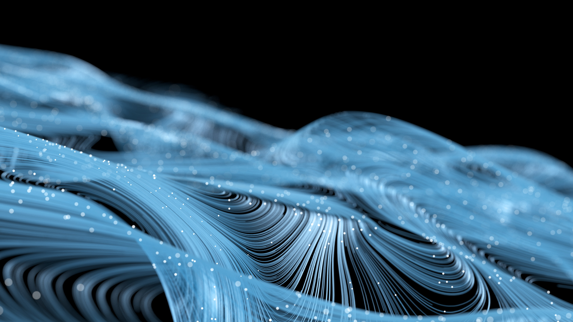
Controlled Image Style Transfer Using Intermediate CNN layers.
Guide: Dr. Kavita A. Sultanpure
Reviewer: Ms. Shreesudha T. Kembhavi
Rishikesh Suryavanshi Roll No: 33372
Class: TE 11 (N11)

Slide 2
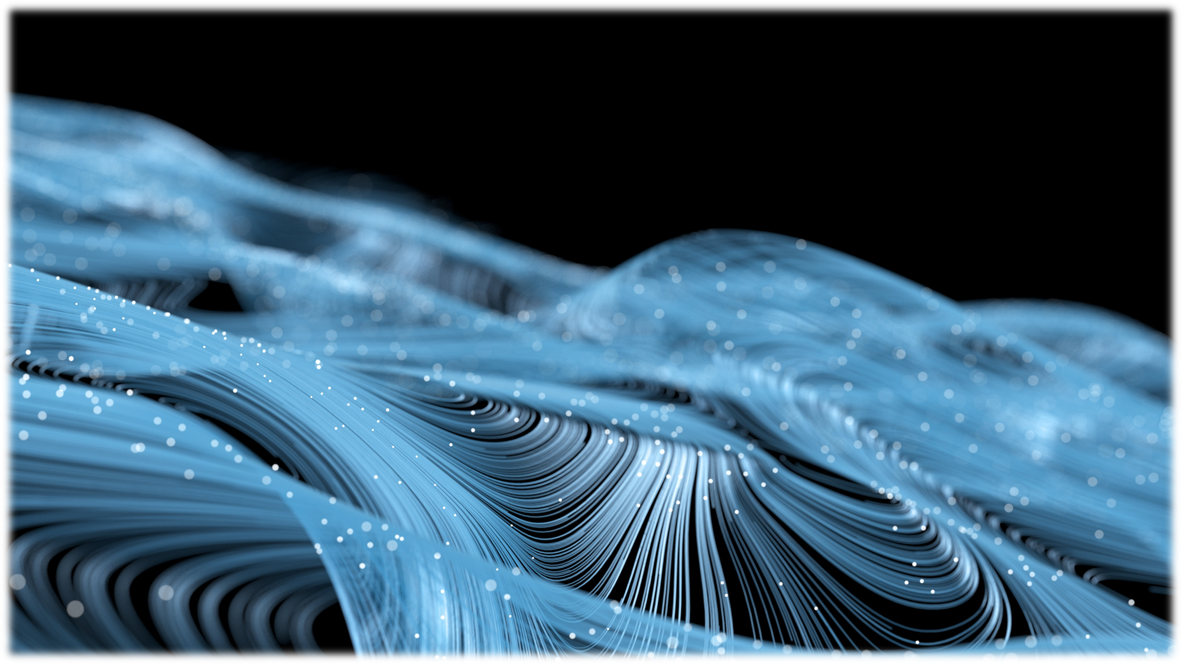
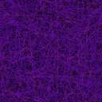
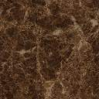

Purpose:
The purpose of the Image Style Transfer technique is to create a new image that combines the content of one image with the style of another image. By using style gram matrix from intermediate Convolution Neural Network layer from a Vgg-19 model, we can adjust and also control the style percentage for any image preserving its content while at the same time transferring the specific amount of style.
Scope:
The image style transfer has a very broad scope. It can be applied to a wide range of images and used for a variety of purposes like creating artistic effects by taking one image’s style and transferring it to other. Image style transfer can be applied to any type of image, including photographs, paintings, and drawings. It can also be used on images of any size or resolution, making it a versatile tool for a wide range of applications. For example, it has been used to improve the quality of images that have been degraded by noise or other distortions, and to automatically colorize black and white images.
Objective:
The objective of image style transfer is to create a new image that combines the content of one image with the style of another image. The content of the image is preserved, while the style is transferred from the source image. Overall, the main objective of image style transfer is to allow people to creatively manipulate and transform images in a way that was not previously possible. This will be a huge step forward for digital and artificial intelligence generated artwork, which will help artists as well as designers in all industries.

Slide 3
Abstract:
Image Style Transfer is a technique in computer vision that focuses on transferring style and characteristics from a certain image to an entirely new never before seen image. The semantic representation of images is carried out using convolutional neural networks, which is a popular neural architecture in deep learning, used popularly for computer vision tasks. The model is a VGG-19 model pre-trained on ImageNet data set which has learned a variety of low-level and high-level features. After processing our image through this model and then taking the intermediate layers will provide us with the style gram matrix which will be further used for style transfer.
The choice of the intermediate layer can be controlled, which will give us images ranging in different style transfer power. This technique can be used in many applications and areas like in the animation industry for visual art creation, art cohesion, art-style interchangeability, image editing, and rendering, etc. It can be extensively used in the AI art generation which recently is in boom and is quickly gaining popularity. The results produced also give an insightful understanding of Convolutional Neural Networks and the deep image representations learned from them. It also demonstrates high-level image synthesis and manipulation potential which can transform how we see creativity and the possibility of Artificial Intelligence learning it.

Slide 4
Introduction to Seminar Topic:
Basic Concepts –
Neural Networks and Deep Learning –
Deep learning is a type of machine learning that involves training artificial neural networks on a large dataset. Deep learning has achieved state-of-the-art results in a variety of applications, including image and speech recognition, natural language processing, and machine translation
A neural network is a type of machine learning model that is inspired by the structure and function of the human brain. It consists of layers of interconnected nodes, called artificial neurons, which process and transmit information. Each neuron receives input from other neurons and uses it to make a decision or prediction, and then passes the result on to other neurons in the next layer. Neural networks are able to learn and adapt to new data by adjusting the strength of the connections between neurons, known as weights. During training, the neural network is presented with a large dataset and uses an optimization algorithm to adjust the weights in a way that minimizes the error between the predicted output and the true output. This process allows the neural network to learn patterns and relationships in the data and make accurate predictions or decisions.
Convolution Layer –
For a colored image the kernel is a 3 by 3 matrix which is applied on the three RGB channels representing red, green and blue information. When multiple kernels are applied, this in turn produce many channels which carry more precise feature information.
Max Pooling Layer –
The maxpooling layer takes the max value of a pixel on a window of 2 by 2, which also helps in reducing unnecessary data and only keep the needed information.

Slide 5
Introduction to Seminar Topic:
Basic Concepts –
Convolution Neural Network –
In computer vision, convolution is a mathematical operation that is used to apply a filter or kernel to an image. The convolution operation involves taking the dot product of the values in the filter with the values in a small region of the image, and summing the results. This process is repeated for every possible location in the image, resulting in a transformed version of the original image.
Convolution is a fundamental operation in image processing and is used in a wide range of applications, including image filtering, edge detection, and feature extraction. It is particularly useful for image analysis tasks that involve analyzing the local relationships between pixels in an image, as it allows for the extraction of important features and patterns.
Convolution is implemented using convolutional neural networks (CNNs), which are a type of neural network specifically designed for image analysis tasks. CNNs are trained to learn the filters and kernels that are used in the convolution operation, allowing them to automatically extract important features from images and use them for tasks such as image classification and object recognition.

Slide 6
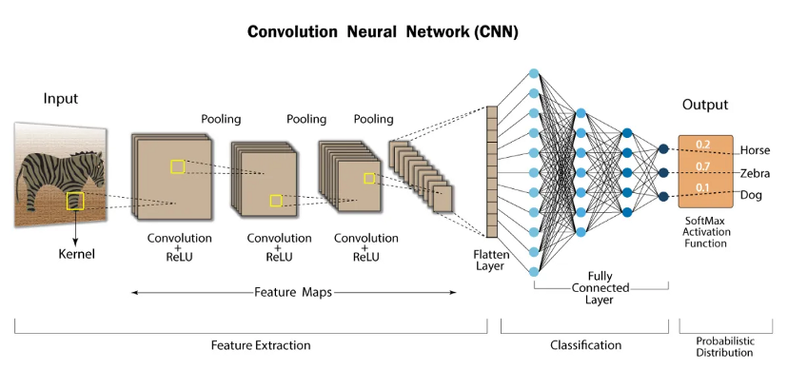
Convolutional layers followed by fully connected neural network layers.
[Source: https://developersbreach.com/convolution-neural-network-deep-learning/]
In machine learning, a cost function is a measure of the error or loss between the predicted output of a model and the true output. The cost function is used to evaluate the performance of the model and guide the optimization process during training. The goal of training a machine learning model is to find the set of parameters that minimizes the cost function, so that the model can make accurate predictions on new data.
An activation function is a mathematical function that is used to introduce nonlinearity into a neural network. Activation functions are applied element-wise to the output of each neuron in the network, and they determine the output of the neuron based on the input received from other neurons. Activation functions allow the network to learn and represent more complex patterns and relationships in the data.
An optimizer is an algorithm that is used to adjust the parameters of a machine learning model in order to minimize the cost function. There are various types of optimizers available, such as gradient descent, stochastic gradient descent, and Adam, which use different strategies to update the model parameters. The choice of optimizer can have a significant impact on the performance of the model, and different optimizers may be more suitable for different types of models and tasks.

Slide 7
Introduction to Seminar Topic:
Concepts In Order To Understand The Seminar Topic –
VGG-19 model – This is a model that first appeared in paper [Very Deep Convolutional Networks for Large-Scale Image Recognition]. It is effective in the large-scale image recognition setting using the deep convolutional network with high accuracy. It uses an architecture with very small (3x3) convolution filters, which have a significant improvement on the prior-art configurations which can be achieved by pushing the depth to 16-19 weight layers. It is used to represent and identify features in the image as we go deeper into the layers. Specifically, we'll use VGG-19, a 19-layer version of the VGG network. This model has already been trained on the very large ImageNet database, and has learned to recognize a variety of low level features (at the shallower layers) and high level features (at the deeper layers). The model is publically available in the tensorflow applications module and can be used in python using this line. It has alternate convolutional and maxpooling layers followed by some fully connected layer and a softmax layer at the end.
tf.keras.applications.VGG19(include_top=False, input_shape=(img_size, img_size, 3), weights='pretrained- model/vgg19_weights_tf_dim_ordering_tf_kernels_notop.h5')

Slide 8
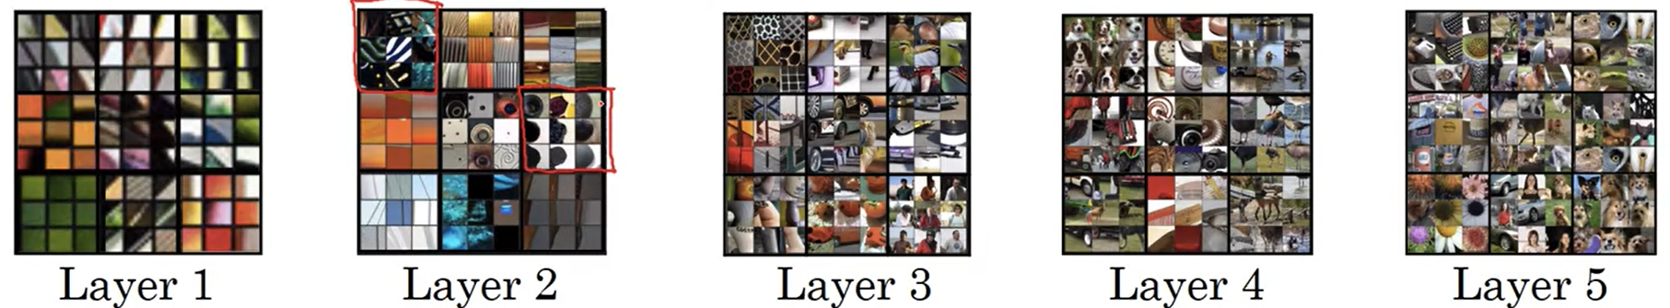
Concepts In Order To Understand The Seminar Topic–
Features Represented By Different Model Layers – The features represented by different layers varies a lot, and in our model which is trained on the very large ImageNet database, it has learned to recognize a variety of low level features (at the shallower layers) and high level features (at the deeper layers). This model was originally used to recognize the image objects, but it has also recognized to extract excellent features as it has been trained on a large dataset . So here we use transfer learning to get the layers of the model which have become excellent at feature identification and extraction. This layer have different channels which represent different things, they might be hard to understand for humans and may not make any sense, but the model has been optimized and can make sense from these different channels. Here is a representation of what the layers may look like – At the shallow levels we have low level features like edge detection and as we go deeper it learns to understand different textures as well as high level features like faces and objects like car and animals.

Slide 9
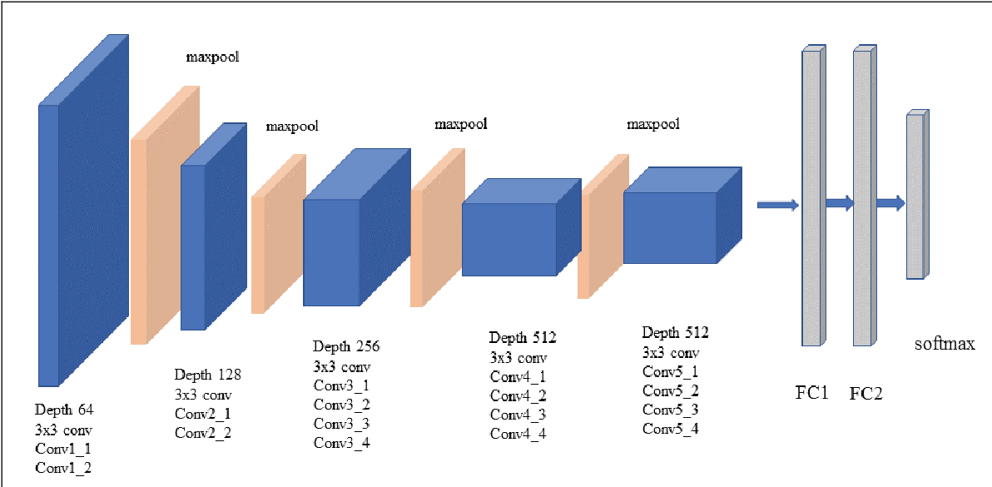
Vgg-19 Model Architecture [Source : https://towardsdatascience.com/extract-features-visualize-filters-and-feature-maps-in-vgg16-and-vgg19-cnn-models-d2da6333edd0]

Slide 10
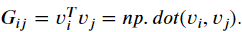
Techniques To Be Explored –
Gram Matrix for Style Representation–
The style matrix is also called a "Gram matrix“. It will be used to represent style of a particular layer.
In linear algebra, the Gram matrix G of a set of vectors (𝑣1,…,𝑣𝑛) is the matrix of dot products.
In other words, 𝐺𝑖𝑗 compares how similar 𝑣𝑖 is to 𝑣𝑗 : If they are highly similar, you would expect them to have a large dot product, and thus for 𝐺𝑖𝑗 to be large.
𝐺(𝑔𝑟𝑎𝑚)𝑖𝑗: correlation–
The result is a matrix of dimension (𝑛𝐶,𝑛𝐶) where 𝑛𝐶 is the number of filters (channels). The value 𝐺(𝑔𝑟𝑎𝑚)𝑖,𝑗 measures how similar the activations of filter 𝑖 are to the activations of filter 𝑗 .
𝐺(𝑔𝑟𝑎𝑚),𝑖𝑖 : prevalence of patterns or textures –
The diagonal elements 𝐺(𝑔𝑟𝑎𝑚)𝑖𝑖 measure how "active" a filter 𝑖 is.
For example, suppose filter 𝑖 is detecting vertical textures in the image. Then 𝐺(𝑔𝑟𝑎𝑚)𝑖𝑖 measures how common vertical textures are in the image as a whole.
If 𝐺(𝑔𝑟𝑎𝑚)𝑖𝑖 is large, this means that the image has a lot of vertical texture.

Slide 11
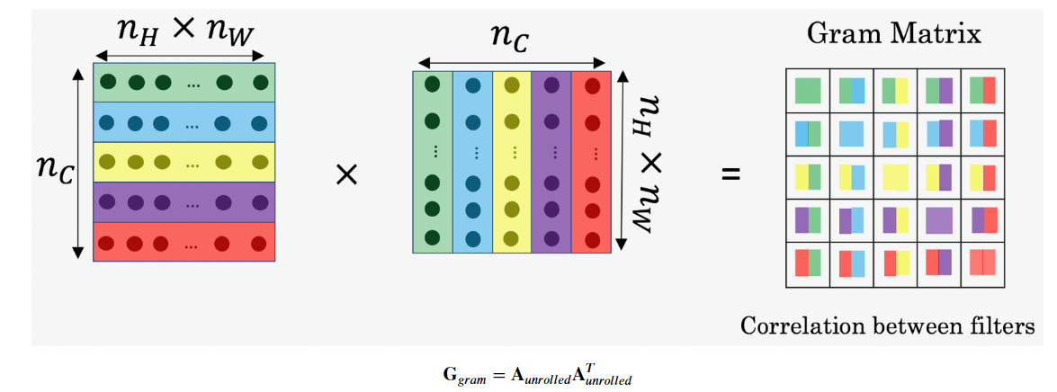
Gram Matrix for Style Representation–
By capturing the prevalence of different types of features ( 𝐺(𝑔𝑟𝑎𝑚)𝑖𝑖 ), as well as how much different features occur together ( 𝐺(𝑔𝑟𝑎𝑚)𝑖𝑗 ), the Style matrix 𝐺𝑔𝑟𝑎𝑚 measures the style of an image.
Compute Gram matrix 𝐺𝑔𝑟𝑎𝑚 –
We will compute the Style matrix by multiplying the "unrolled" filter matrix with its transpose.
Different activation functions like relu, sigmoid, softmax, etc and different optimization algorithms like Adam, Stochastic gradient descent, Batch gradient descent, RMSprop, etc. will be discovered to get the best results for the image style transfer for a large set of images.
Calculation of gram matrix from different layers [Source: deeplearning.ai]

Slide 12
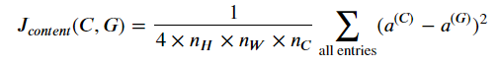
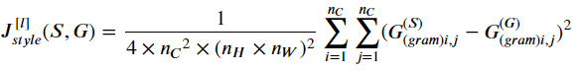
Content Cost Function 𝐽𝑐𝑜𝑛𝑡𝑒𝑛𝑡(𝐶,𝐺)
One goal we aim for when performing Neural Style Transfer is for the content in generated image G to match the content of image C. A method to achieve this is to calculate the content cost function, which will be defined as:
Here, 𝑛𝐻,𝑛𝑊 and 𝑛𝐶 are the height, width and number of channels of the hidden layer you have chosen, and appear in a normalization term in the cost.
Note that 𝑎(𝐶) and 𝑎(𝐺) are the 3D volumes corresponding to a hidden layer's activations.
Style Cost Function 𝐽[𝑙]𝑠𝑡𝑦𝑙𝑒(𝑆,𝐺)
Our next goal isto minimize the distance between the Gram matrix of the "style" image S and the Gram matrix of the "generated" image G.
Here we have –
𝐺(𝑆)𝑔𝑟𝑎𝑚 Gram matrix of the "style" image.
𝐺(𝐺)𝑔𝑟𝑎𝑚 Gram matrix of the "generated" image.
This cost is computed using the hidden layer activations for a particular hidden layer in the network 𝑎[𝑙].

Slide 13




Implementation
Steps carried out during Implementation in Jupyter Notebook:
Transfer Learning
Neural Style Transfer (NST)
1 - Computing the Content Cost
1.1 - Make Generated Image G Match the
Content of Image C
1.2 - Content Cost Function 𝐽𝑐𝑜𝑛𝑡𝑒𝑛𝑡(𝐶,𝐺)
2 - Computing the Style Cost
2.1 - Style Matrix
2.2 - Style Cost
2.3 - Style Weights
3 - Defining the Total Cost to Optimize
Solving the Optimization Problem
1 - Load the Content Image
2 - Load the Style Image
3 - Randomly Initialize the Image to be Generated
4 - Load Pre-trained VGG19 Model
5 - Compute Total Cost
5.1 - Compute Content Cost
5.2 - Compute Style Cost
6 - Train the Model
Libraries Used
Scipy- A versatile Python library for scientific computing. It offers a wide range of functions for numerical tasks, including integration, optimization, interpolation, linear algebra, signal processing, statistics, and handling sparse matrices.
Matplotlib- A popular Python library for creating visualizations and plots. It offers a wide range of functions for generating various types of plots, with customizable features for axes, labels, colors, and styles.
Numpy- A core Python library for numerical computing, offering efficient multidimensional array operations. It provides high-performance array manipulation, mathematical functions, and tools.
Tensorflow- A popular Python library for ML and deep learning. Provides flexible framework for building and training neural networks. Widely used for tasks like image recognition and natural language processing, thanks to its efficient tensor computation and extensive collection of pre-built neural network components.

Slide 14
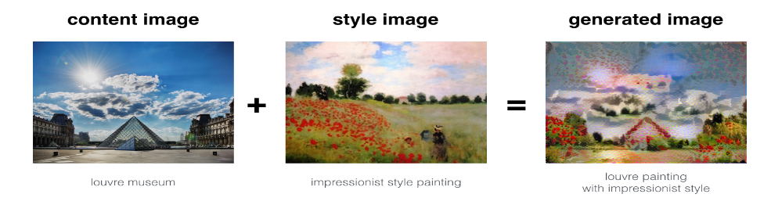
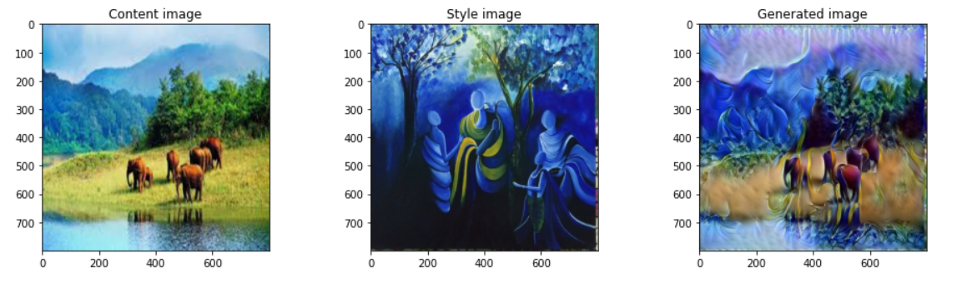

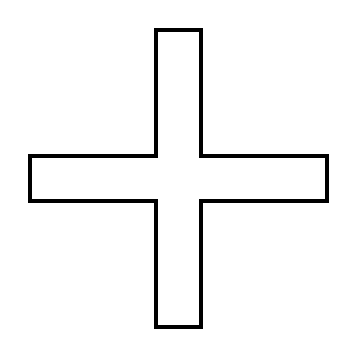
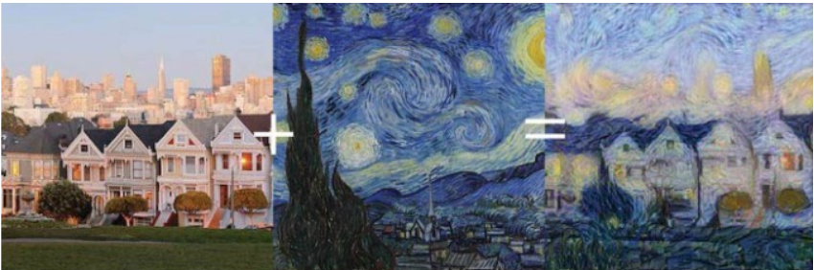

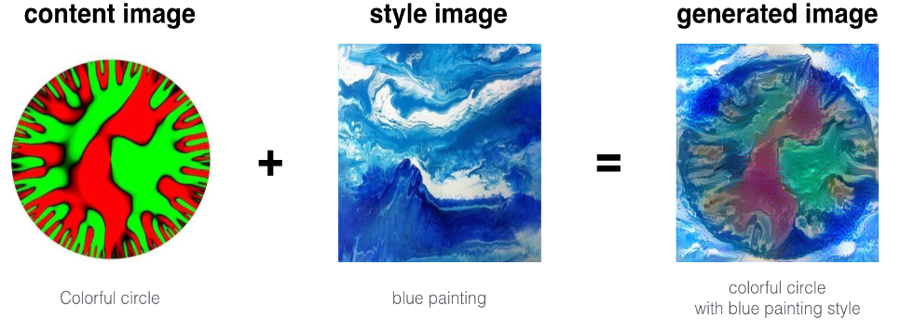
Results :

Slide 15
Probable Applications:
Artistic effects: Image style transfer can be used to create a wide range of creative effects, such as making a photograph look like a watercolor painting or a sketch. This can be used for artistic purposes, such as creating unique works of art or adding creative flair to photographs.
Image enhancement: Image style transfer can be used to improve the quality of images that have been degraded by noise or other distortions. This can be useful for restoring old or damaged photographs, or for improving the appearance of images that have been captured under less-than-ideal conditions.
Colorization: Image style transfer can be used to automatically colorize black and white images. This can be useful for adding color to historical photographs or other images that were originally captured in black and white.
Graphic design: Image style transfer can be used to create custom graphics or logos that combine the content of one image with the style of another image. This can be useful for creating professional-looking graphics without requiring advanced design skills.
Machine learning research: Image style transfer is a popular topic in machine learning research, and there are many ongoing efforts to improve the accuracy and efficiency of style transfer algorithms. This research has the potential to lead to new and innovative applications for image style transfer.

Slide 16


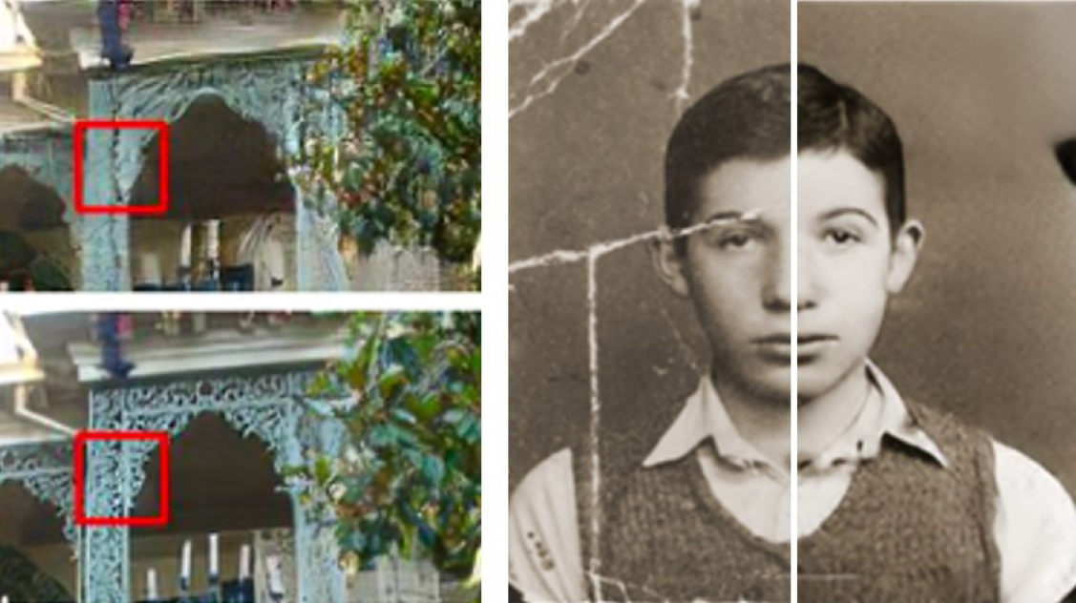
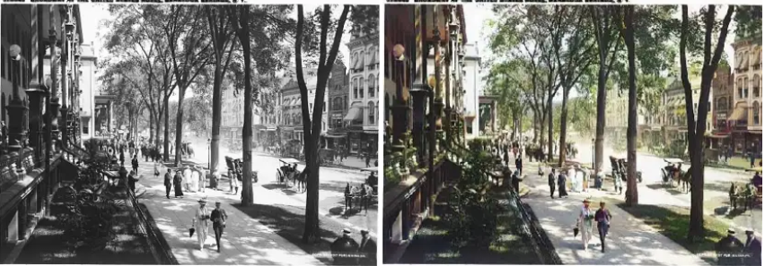


Slide 17
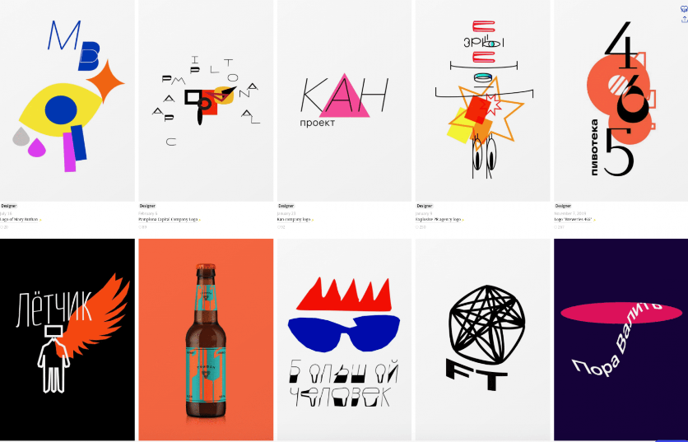

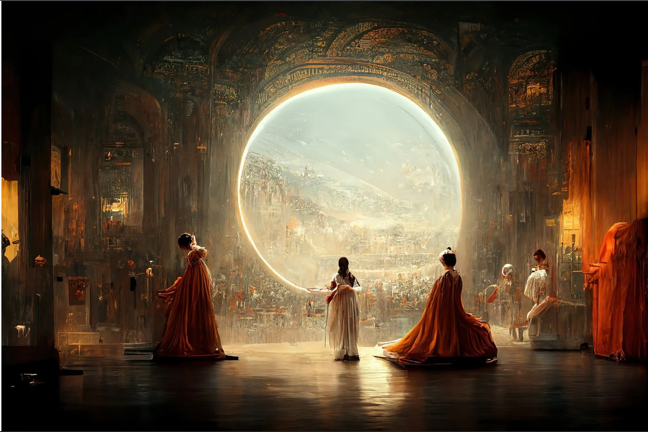


Slide 18
Conclusion:
Image style transfer is a technique that combines the content of one image with the style of another image to create a new, synthesized image. This can be achieved through a variety of methods, including neural style transfer and texture synthesis. The goal of image style transfer is to produce an image that preserves the content of the original image while adopting the style of the reference image. It can be used for a variety of applications, including art, design, photography, and entertainment.
Overall, image style transfer is a powerful tool for creating unique, stylized images that incorporate the best aspects of multiple images. It allows for a high degree of artistic expression and creativity, and can be used to produce a wide range of visually appealing results.
The use of gram matrix for representing style of any image is possible through the use of specific layers of CNN after the image is passed through the Vgg-19 model. This style matrix can now be used on another image to define a loss function, and by adjusting the style loss and contest loss variables we can get a desired effect. This is a part of Artificial Intelligence generated artwork which can replicate human creativity.
The rise of computer vision and new generative algorithms can be a huge benefit to all industries. If not real artwork, it can act as inspirational and motivational work,to which human touch and magic can be applied to create something never possible before. AI generated art has already won a lot of competition and is also being is used in cool human portray generation in practically no time and is almost free of cost and can be accessed by everyone.

Slide 19
Reference:
Images:
1-deeplearning.ai
2-https://www.microsoft.com/en-us/research/blog/enhancing-your-photos-through-artificial-intelligence/
3-(https://www.loc.gov/pictures/item/2016818127/) (right) colorized photo
4-Credit: Art. Lebedev Studio
5-Jason Allen’s A.I.-generated work, “Théâtre D’opéra Spatial,” took first place in the digital category at the Colorado State Fair.Credit...via Jason Allen.
Papers:
1 - Image Style Transfer Using Convolutional Neural Networks [https://www.cv-foundation.org/openaccess/content_cvpr_2016/papers/Gatys_Image_Style_Transfer_CVPR_2016_paper.pdf]
2 - A Neural Algorithm of Artistic Style [arXiv:1508.06576v2 [cs.CV] 2 Sep 2015]
3 - Deep Photo Style Transfer [arXiv:1703.07511v3 [cs.CV] 11 Apr 2017]
4 - Universal Style Transfer via Feature Transforms [arXiv:1705.08086v2 [cs.CV] 17 Nov 2017]
Websites:
1 – DeepLearning.ai
2 - https://towardsdatascience.com/light-on-math-machine-learning-intuitive-guide-to-neural-style-transfer-ef88e46697ee
3 - https://medium.com/mlearning-ai/image-detection-using-convolutional-neural-networks-89c9e21fffa3

